Slide 1
Verifying Dafny Contract Integrity
Cassidy Waldrip
Brigham Young University

Slide 2
Goal: help Dafny users to write good program specifications.

Slide 3
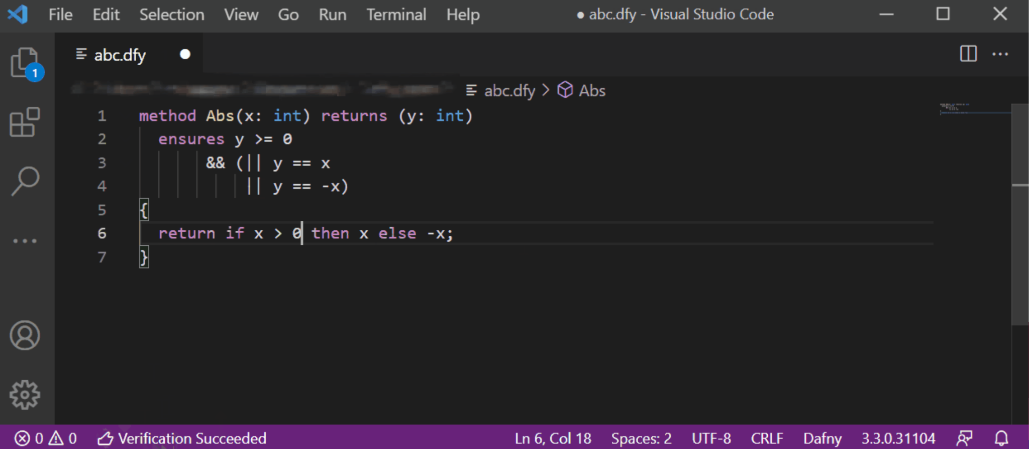
The Dafny programming language

Slide 4
Dafny proves that implementations are safe substitutions for contracts… but that only matters if the contract has integrity.
Integrity means the contract is free of: contradictions, vacuity, unconstrained outputs, and redundancy.

Slide 5
Related work
Dafny 4.4.0:
SMT unsatisfiable cores vs. new verification conditions
Uses implementations
Other related work:
Model checking to detect contract issues (Barnat et al.)
SMT solver for detecting contradictions (Filipovikj et al.)
Leveraging Dafny backend (Fedchin et al.)

Slide 6
Contradiction
method Contradiction(a : int, b : int)
requires a != b && a == b
{ … }
X
Not satisfiable!
assert !(a != b && a == b);
if assertion is proven, then we have a contradiction

Slide 7
Vacuity
method Vacuous(a: int)
requires false ==> a > 0
{ … }
Vacuously true
X
assert false ==> a > 0;
if assertion is proven, then we have vacuity

Slide 8
Unconstrained outputs
method Unconstrained(a: int, b: int) returns (result: int)
requires a > 0 && b > 0
ensures a > b ⇒ result == a
ensures b > a ⇒ result == b
{ … }
What about if a == b? Anything goes!

Slide 9
Unconstrained outputs
method Unconstrained(a: int, b: int) returns (result: int)
requires a > 0 && b > 0
ensures a > b ⇒ result == a
ensures b > a ⇒ result == b
{ … }
assert a > 0 && b > 0 ⇒ (a > b || b > a);
X
Does not prove out! Result is unconstrained

Slide 10
Redundancy
method Redundant(a: int, b: int)
requires a == 1
requires a != -1
requires b > 0
X
Redundant
Detection: are any contract clauses implied by other parts of the contract?

Slide 11
Redundancy
requires a == 1
requires a != -1
requires b > 0
Tautology, so a != -1 is redundant
✔
assert a == 1 && a != -1 ⇒ b > 0;
assert a == 1 && b > 0 ⇒ a != -1;
assert a != -1 && b > 0 ⇒ a == 1;
X
✔

Slide 12
Approach
Leverage Dafny backend (Boogie, Z3)
Use Dafny rewriters to generate assertions that test for pitfalls (thank you, Aaron Tomb!)

Slide 13
Approach
method BinarySearch(a: array<int>, key: int) returns (r: int)
requires a.Length > 0
requires forall i : int, j : int :: 0 <= i <= j < a.Length
==> a[i] < a[j]
requires 0 < key < a.Length - 1 ==> a[key] <= a[key + 1]
ensures r > 0 ==> a[r] == key
ensures r < 0 ==> key !in a[..]
Run Dafny with /contractIntegrity option:
https://github.com/byu-dafny/dafny/tree/contract_integrity

Slide 14

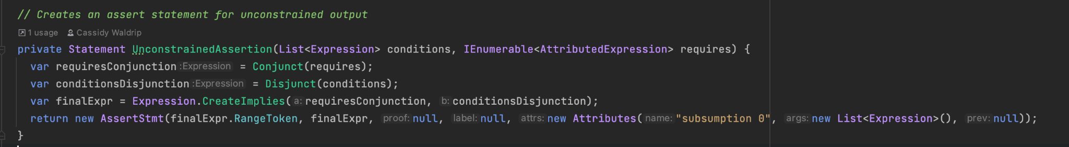
Approach

Slide 15
Approach
assert (a.Length > 0
&& forall i : int, j : int :: 0 <= i <= j < a.Length
==> a[i] < a[j])
==> 0 > key > a.Length - 1 ==> a[key] <= a[key + 1];
X
This proves out, so the implied clause is redundant!

Slide 16
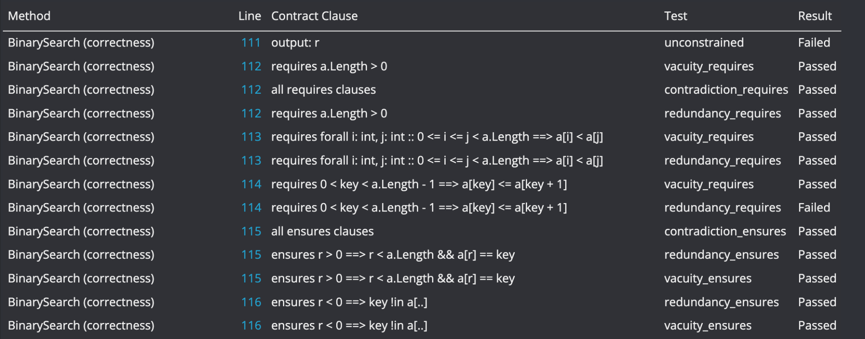
Approach

Slide 17
Results
 | # of contracts (methods) | # of requires / ensures clauses | Avg. length of contract clause | % false positives | # of issues detected + validated
some_tests.dfy | 21 | 20 / 15 | 6.8 words | 0 | 31
satellite_uplink.dfy | 10 | 10 / 20 | 4.9 words | 0 | 4
sha3.dfy | 9 | 9 / 16 | 4.2 words | 0 | 0
tokeneer.dfy | 2 | 2 / 4 | 3.7 words | 0 | 0
bounded.dfy | 4 | 0 / 25 | 5.1 words | 0 | 5
integer_set.dfy | 6 | 6 / 17 | 16.3 words | 16.7 | 3
Unconstrained output + redundancy
Examples available at: https://github.com/byu-dafny/test-generation-examples

Slide 18
Results
Handled correctly:
binary operators, function calls, objects and datatypes, implication, universal quantification
Handled incorrectly:
existential quantification (negation of universal quantification)

Slide 19
Future work
Main problem: existential quantification
Other additions:
more informed feedback for fixing issues
better redundancy detection

Slide 20
Acknowledgements
Advisor:
Dr. Eric Mercer
Others:
Aaron Tomb (AWS)
Ben Taylor, Gavin Steck, Parker Hanson (BYU)

Slide 21
Questions?

